Slide 1
Social Determinants of Mental Health
for Interprofessional Education
Notes:
IMPORTANT NOTES:
These slides are based on the workshop of the Global Forum on Innovation in Health Professional Education and its subsequent written proceedings. Users of the slides should adapt this slide deck to meet the needs of a particular presentation.
Recommend showing 1min video of the workshop recap before starting the presentation: [See third slide]
When adapting this slide deck, users can choose to apply the preset learning objectives for IPE (slide 2a), mental health (2b), or advocacy (2c), or set up their own learning objectives stemming from the master list (slide 2). Users can select subsequent slides and content that match their topic. Some of the content in the slide may be better presented orally. Users should not over-pack each slide with information and they should apply an attractive background to personalize the slide deck and to enhance the educational experience.
Optional interactive activities are embedded in select slides and can be used to engage the participants. The case histories at three points across the life course (i.e., pregnancy, adolescence, and older adulthood) can also be used to actively engage participants in small group discussions.
LINKS TO SUPPLEMENTAL MATERIAL:
These slides were adapted from Appendix E of the report, Educating Health Professionals to Address the Social Determinants of Mental Health: Proceedings of a Workshop (2020) – (https://www.nap.edu/read/25711/chapter/11?term=appendix#77)
Workshop proceedings: https://www.nap.edu/download/25711#
Workshop videos: https://www.youtube.com/playlist?list=PLGTMA6QkejfhAmRC2HbVGC460j7RyU9WW
Speaker ppts: https://www.nationalacademies.org/event/11-14-2019/educating-health-professionals-to-address-the-social-determinants-of-mental-health-a-workshop#sectionEventMaterials
Speaker bios (Appendix C): https://www.nap.edu/read/25711/chapter/9

Slide 2
Cite Attribution to:
Global Forum on Innovation in Health Professional Education
Of the National Academies of Sciences, Engineering, and Medicine
https://www.nationalacademies.org/event/11-14-2019/educating-health-professionals-to-address-the-social-determinants-of-mental-health-a-workshop
THE USE OF THESE SLIDES ARE FOR EDUCATION PURPOSES ONLY
Notes:
Cite proceedings or the workshop as indicated below:
National Academies of Sciences, Engineering, and Medicine. 2020. Educating Health Professionals to Address the Social Determinants of Mental Health: Proceedings of a Workshop. Washington, DC: The National Academies Press. https://doi.org/10.17226/25711.
Global Forum on Innovation in Health Professional Education. (2019, November 14-15). Educating health professionals to address the social determinants of mental health: A workshop. National Academies of Sciences, Engineering, and Medicine. https://www.nationalacademies.org/event/11-14-2019/educating-health-professionals-to-address-the-social-determinants-of-mental-health-a-workshop
Use of any of the resource slides for publication, or for purposes outside of education, will require written consent from the organization noted in the ”source” as noted below.
The report cover can be used without permission
The video can be used without permission
For specific content attributed to an individual, you will need to note: “Used with permission from (individual citation)” and the statement at the end noting “Copyright by National Academy of Sciences, Washington, DC.
For information provided by the National Academy of Sciences for noncommercial use, include the following language: “Copyright by National Academy of Sciences, Washington, DC. Permission is granted to reproduce this material with no additions or alterations, for educational, not-for-profit use only. For all other requests, please contact permissions@nas.edu.”

Slide 3
1 minute video on the Social Determinants of Mental Health
Note: Must be in presentation mode for hyperlink to work
Notes:
Click slide in presentation mode or use this you tube link to show video: https://www.youtube.com/watch?v=zqvF6W5kKEY&mc_cid=6c3579abd0&mc_eid=7097eb5cb6

Slide 4
Overall Learning Objectives
Understand the impact of the social determinants of mental health across the lifespan
Understand how mental health can be incorporated into the HPE framework for the social determinants of health
Differentiate the impact of the social determinants on physical and mental health at macro, meso, and micro levels
Examine opportunities to expand health professional education to incorporate the social determinants of mental health
Identify experiential learning opportunities related to the social determinants of mental health for health professional education
Design a framework for delivering education on the social determinants of mental health to health professionals-in-training
Implement strategies for health professional education that incorporate the social determinants of mental health
Notes:
From workshop video see Carl Sheperis [2:30-7:00]
https://www.youtube.com/watch?v=zibAkecAmGc&list=PLGTMA6QkejfhAmRC2HbVGC460j7RyU9WW&index=1
In the report prepublication see:
Page 5: https://www.nap.edu/read/25711/chapter/2?term=%22learning+objectives%22#5
“Sheperis then introduced the participants to the learning objectives of the workshop (see Box 1-3). He stressed that the workshop was designed for active participation, and he encouraged the audience to think critically about what they would like to learn at the workshop, what personal experiences they brought to the workshop, and how they would move forward to integrate the social determinants of mental health into health professional education.”
Ask the participants or class members to:
Think about your own experiences with the SDH throughout the day’s discussions
Develop a personal learning contract of what s/he intends to do
NOTE: The user of these slides may want to select specific learning objectives that match the purpose of the user’s activity. Slides a, b, & c suggest learning objectives for IPE, mental health, and life long learning, respectively

Slide 5
Key Learning Objectives for IPE
a
Understand the impact of the social determinants of mental health across the lifespan
Understand how mental health can be incorporated into the HPE framework for the social determinants of health
Differentiate the impact of the social determinants on physical and mental health at macro, meso, and micro levels
Examine opportunities to expand health professional education to incorporate the social determinants of mental health
Identify experiential learning opportunities related to the social determinants of mental health for health professional education
Design a framework for delivering education on the social determinants of mental health to health professionals-in-training
Implement strategies for health professional education that incorporate the social determinants of mental health
Notes:
From workshop video see:
Multiple sectors working together, Shim: 32:50: https://www.youtube.com/watch?v=j2UpZ-ELxA8&list=PLGTMA6QkejfhAmRC2HbVGC460j7RyU9WW&index=3&t=45s
In the report prepublication see:
Pages 14-15: https://www.nap.edu/read/25711/chapter/3#14
“Moving the needle on the SDMH will require health professionals to step outside of their professions and to collaborate across sectors in order to influence and form relationships with elected officials. Shim said that in her profession of psychiatry, many psychiatrists want to stay within the field and only work with other psychiatrists. But to have a true impact, they really need to work with groups outside of the health professions such as police officers, teachers, lawyers, and city planners.”
NOTE: This slide suggests specific learning objectives for interprofessional education

Slide 6
Key Learning Objectives for Incorporating MH into SDH Education
b
Understand the impact of the social determinants of mental health across the lifespan
Understand how mental health can be incorporated into the HPE framework for the social determinants of health
Differentiate the impact of the social determinants on physical and mental health at macro, meso, and micro levels
Examine opportunities to expand health professional education to incorporate the social determinants of mental health
Identify experiential learning opportunities related to the social determinants of mental health for health professional education
Design a framework for delivering education on the social determinants of mental health to health professionals-in-training
Implement strategies for health professional education that incorporate the social determinants of mental health
Notes:
From workshop video see:
Shim, social norms [35:45]: https://www.youtube.com/watch?v=j2UpZ-ELxA8&list=PLGTMA6QkejfhAmRC2HbVGC460j7RyU9WW&index=3&t=45s
In the report prepublication see:
Page 15: https://www.nap.edu/read/25711/chapter/3#15
In concert with political advocacy, Shim said, there is a need to change the social norms concerning mental health, inclusion, and mutual respect. “We need to create social norms of tolerance, acceptance, and inclusion,” she said, and speak up when these norms are not being respected. When people are being “exclusionary, racist, sexist, homophobic, [or] transphobic,” she said, “it’s on all of us to be the person that speaks up in those situations.”
NOTE: This slide suggests specific learning objectives for mental health

Slide 7
Key Learning Objectives for SDH/SDMH LLL and Advocacy Training
c
Understand the impact of the social determinants of mental health across the lifespan
Understand how mental health can be incorporated into the HPE framework for the social determinants of health
Differentiate the impact of the social determinants on physical and mental health at macro, meso, and micro levels
Examine opportunities to expand health professional education to incorporate the social determinants of mental health
Identify experiential learning opportunities related to the social determinants of mental health for health professional education
Design a framework for delivering education on the social determinants of mental health to health professionals-in-training
Implement strategies for health professional education that incorporate the social determinants of mental health
Notes:
From workshop video see policy & advocacy
David Benedek: 3min
https://www.youtube.com/watch?v=Pxjs6sMCYHc&list=PLGTMA6QkejfhAmRC2HbVGC460j7RyU9WW&index=18&t=126s
Seth Moulton: 32min
https://www.youtube.com/watch?v=ejQxUbXGz3k&list=PLGTMA6QkejfhAmRC2HbVGC460j7RyU9WW&index=19&t=574s
Ruth Shim
[29:00-38:00]: https://www.youtube.com/watch?v=j2UpZ-ELxA8&list=PLGTMA6QkejfhAmRC2HbVGC460j7RyU9WW&index=3&t=45s
In the report prepublication see:
Chapter 5:
Chapter 3, Page 14: https://www.nap.edu/read/25711/chapter/3#13
Social norms and public policy influence one another, and both affect how a society chooses to distribute resources. This distribution of resources affects social determinants such as housing and food security, access to health care, environmental exposures, education, employment, and interaction with the criminal justice system. These determinants, in turn, affect behavioral risk factors, physical and mental stress, and the options that people have at their disposal. These factors then affect mental and physical health outcomes. Given the intimate relationship between politics and health, Shim said, health professionals have a responsibility to advocate for policies that improve the SDH. “All policies are health policies,”2 Shim said. All policies have an impact on people’s health and mental health, yet “we don’t always consider what that impact is before we enact laws.”
NOTE: This slide suggests specific learning objectives for life long learning

Slide 8
What are the Social Determinants of Health (SDH)?
SDH is defined as “those factors that impact upon health and wellbeing: the circumstances into which we are born, grow up, live, work, and age, including the health system” (CSDH, 2008).
Notes:
From workshop video see Ruth Shim: [3:40-4:40]
https://www.youtube.com/watch?v=j2UpZ-ELxA8&list=PLGTMA6QkejfhAmRC2HbVGC460j7RyU9WW&index=2
In the report prepublication see:
Page 8: https://www.nap.edu/read/25711/chapter/3#8
WHO Reference: https://www.who.int/social_determinants/thecommission/finalreport/key_concepts/en/

Slide 9
What are the Social Determinants of Mental Health (SDMH)?
SDMH involve the economic, social and political conditions into which one is born that dictate the likelihood a person raised in deficient or dangerous conditions often associated with poverty will develop persistent mental health challenges throughout his or her life (WHO and Calouste Gulbenkian Foundation, 2014).
Adapted from the World Health Organization (WHO) and the Calouste Gulbenkian Foundation (2014),
Notes:
From workshop video see Carl Sheperis [2:52-3:50]
https://www.youtube.com/watch?v=zibAkecAmGc&list=PLGTMA6QkejfhAmRC2HbVGC460j7RyU9WW&index=1
From workshop video see Ruth Shim [12:40-14:05]
SDH/MH: https://www.youtube.com/watch?v=j2UpZ-ELxA8&list=PLGTMA6QkejfhAmRC2HbVGC460j7RyU9WW&index=2
Shim presentation:
In the report prepublication see:
Page 2: https://www.nap.edu/read/25711/chapter/2

Slide 10
Social Determinants of Health (SDH)
The SDH, said Shim, are predominantly responsible for the health disparities and health inequities that are seen both within and between countries. These terms – disparities and inequities – are often confused, although they are distinct concepts:
Health disparities: differences in health status among distinct segments of the population including differences that occur by gender, race or ethnicity, education or income, disability, or living in various geographic localities.
Health inequities: disparities in health that are a result of systemic, avoidable, and unjust social and economic policies and practices that create barriers to opportunity.
Notes:
From workshop video see Ruth Shim [4:10-6:50]
https://www.youtube.com/watch?v=j2UpZ-ELxA8&list=PLGTMA6QkejfhAmRC2HbVGC460j7RyU9WW&index=2
In the report prepublication see:
Page 9: https://www.nap.edu/read/25711/chapter/3#8

Slide 11
SDMH Highlights
It is not just the physical health or the mental health of a person that requires support; moving forward, health professionals must bring together the mind and body so learners and practitioners can recognize the importance of caring for the whole person. (Sheperis)
The social determinants of mental health deserve equal attention to the social determinants of physical health because mental health conditions have high costs, prevalence, morbidity, and mortality, and they have been neglected in conversations about social determinants. (Shim)
All policies have an impact on people’s mental and physical health, and health professionals have a responsibility to advocate for policies that will improve health. (Shim)
There is a lack of mental health incorporation into health professional education outside of the mental and behavioral health professions. (Sheperis & Talib)
Notes:
ACTIVITY: Reflect on living histories in terms of the social determinants of health
In the report prepublication see:
Page 1: https://www.nap.edu/read/25711/chapter/2
Page 7: https://www.nap.edu/read/25711/chapter/3

Slide 12
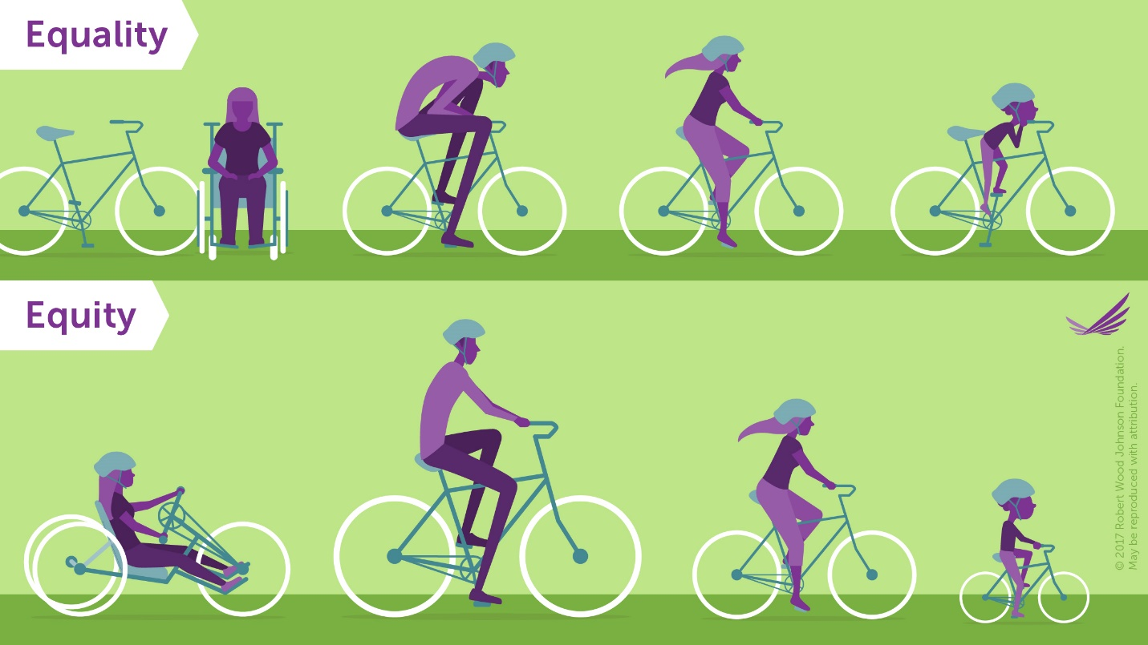
The Difference Between Equality and Equity
SOURCE Presented by Shim on November 14, 2019; RWJF. 2017. Visualizing health equity: One size does not fit all infographic. https://www.rwjf.org/en/library/infographics/visualizing-health-equity.html (accessed January 22, 2020). Copyright 2017. Robert Wood Johnson Foundation. Used with permission from the Robert Wood Johnson Foundation.
Notes:
From workshop video see Ruth Shim [17:43-18:50]
https://www.youtube.com/watch?v=j2UpZ-ELxA8&list=PLGTMA6QkejfhAmRC2HbVGC460j7RyU9WW&index=2
In the report prepublication see:
Page 14: https://www.nap.edu/read/25711/chapter/3#13
Note: For use of this slide image, please seek permission directly from the Robert Wood Johnson Foundation.

Slide 13
SDH Outcomes
Derived from a children’s game of “why”?
Why is Jason in the hospital? - Because he has a bad infection in his leg.
But why does he have an infection? - He has a cut on his leg and it got infected.
But why does he have a cut on his leg? He was playing in a junk yard next to his apartment building and fell on some sharp, jagged steel there.
But why was he playing in a junk yard? His neighborhood is run down. Kids play there and there is no one to supervise them.
But why does he live in that neighborhood? His parents can’t afford a nicer place to live.
But why can’t his parents afford a nicer place to live? His dad is unemployed and his mom is sick.
But why is his dad unemployed? Because he doesn’t have much education and he can’t find a job.
But why….?
Source: Government of Canada. 2013. What makes Canadians healthy or unhealthy? https://www.canada.ca/en/public-health/services/health-promotion/population-health/what-determines-health/what-makes-canadians-healthy-unhealthy.html (accessed January 22, 2020
Notes:
From workshop video see Ruth Shim [6:47-8:15]
https://www.youtube.com/watch?v=j2UpZ-ELxA8&list=PLGTMA6QkejfhAmRC2HbVGC460j7RyU9WW&index=2
In the report prepublication see:
Page 9: https://www.nap.edu/read/25711/chapter/3#9

Slide 14
Poor Mental Health Outcomes
Poor mental health outcomes, said Shim, have been associated with multiple social determinants, including adverse childhood experiences, discrimination, poverty, unemployment, income inequality, food insecurity, and the built environment.
Notes:
From workshop video see Ruth Shim [12:40-14:05]
https://www.youtube.com/watch?v=j2UpZ-ELxA8&list=PLGTMA6QkejfhAmRC2HbVGC460j7RyU9WW&index=2
In the report prepublication see:
Page 12: https://www.nap.edu/read/25711/chapter/3#12

Slide 15
Separating MH Disorders from SDH
Mental health (MH) disorders are particularly difficult to separate from social determinants, said Shim, because conditions are “filtered through the lens of society” and diagnoses are, in large part, based on observations and interpretations of behavior.
Behaviors may have different underlying reasons, but these reasons are often not considered when making a diagnosis.
For example, said Shim, a child who is hyperactive and disruptive in class may be diagnosed with attention deficit hyperactivity disorder. However, these behaviors may be more readily explained by the fact that the child is hungry. Social determinants such as food insecurity may not only be associated with mental health disorders, but may in fact be confounded with them.
Notes:
From workshop video see Intersectionality discussed by Ruth Shim [16:07-17:43]
https://www.youtube.com/watch?v=j2UpZ-ELxA8&list=PLGTMA6QkejfhAmRC2HbVGC460j7RyU9WW&index=2
From workshop video see Carl Sheperis [19:00-29:00]
https://www.youtube.com/watch?v=zibAkecAmGc&list=PLGTMA6QkejfhAmRC2HbVGC460j7RyU9WW&index=1
In the report prepublication see:
Page 12: https://www.nap.edu/read/25711/chapter/3#12

Slide 16
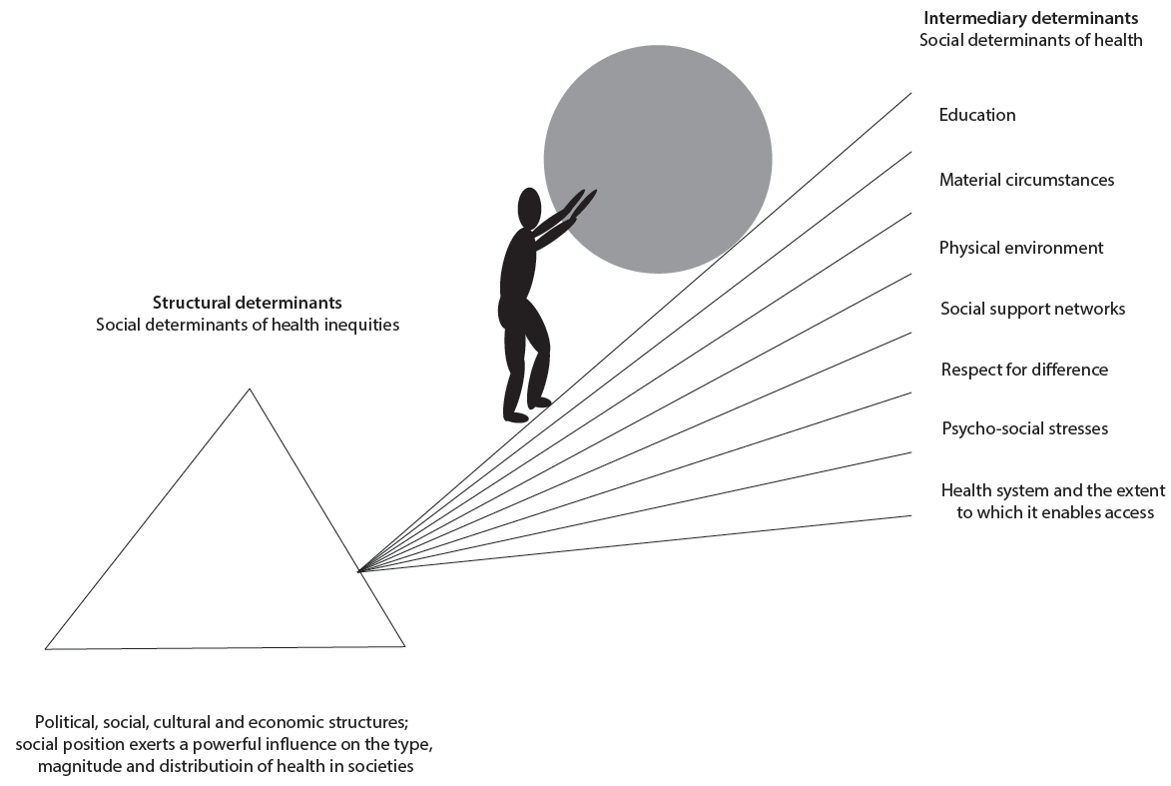
The Impact of Social Determinants
SOURCE Presented by Julian Fisher on November 14, 2019. Intermediary determinants listed (environmental hazards, food/nutrition, housing, employment, education, poverty) based on WHO Commission on the Social Determinants of Mental Health.
Notes:
ACTIVITY: Ask the audience to discuss where “they” are on the social gradient
From workshop video see Julian Fisher [3:40- 7:45]
https://www.youtube.com/watch?v=TKRgkEY2xeY&list=PLGTMA6QkejfhAmRC2HbVGC460j7RyU9WW&index=3
In the report prepublication see:
Page 17: https://www.nap.edu/read/25711/chapter/3#17
The SDMH, Fisher said, can be compared to the slope of a hill. Achieving good health outcomes requires pushing a rock up the hill, but the steeper the slope, the harder it is to push (see Figure 2-5). For individuals who have a good income, stable employment, higher education qualifications, secure housing, and good access to food, the slope is shallow, and it is fairly easy to push the rock. For individuals who face greater challenges because of poverty, lack of education and employment opportunities, and lack of access to healthy options, the slope is steep, and it is difficult or nearly impossible to hold the rock steady or push it up the slope.

Slide 17
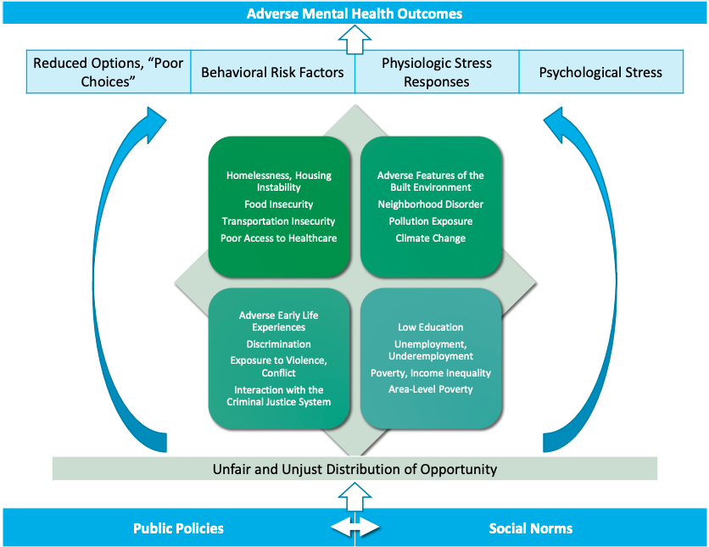
Types of SDMH and Their Causes and Consequences
SOURCE Presented by Shim on November 14, 2019; Created by Ruth Shim, M.D., M.P.H. and Michael T. Compton, M.D., M.P.H.
Notes:
From workshop video see Ruth Shim [19:25-29:00]
https://www.youtube.com/watch?v=j2UpZ-ELxA8&list=PLGTMA6QkejfhAmRC2HbVGC460j7RyU9WW&index=2
In the report prepublication see:
Page 15: https://www.nap.edu/read/25711/chapter/3#15
The mechanism by which political choices affect health outcomes, Shim said, can be seen in Figure 2-4. Social norms and public policy influence one another, and both affect how a society chooses to distribute resources. This distribution of resources affects social determinants such as housing and food security, access to health care, environmental exposures, education, employment, and interaction with the criminal justice system. These determinants, in turn, affect behavioral risk factors, physical and mental stress, and the options that people have at their disposal. These factors then affect mental and physical health outcomes.
Note: To use this slide image, please seek permission directly from the authors Ruth Shim and Michael T Compton.

Slide 18
From Knowledge to Action: Highlights
Contained in National Academies’ report on Educating health professionals to address the social determinants of mental health was the need to emphasize experiential learning that is interprofessional and cross-sectoral. (Fisher)
Both learners and practitioners need to practice in such a way that acknowledges and addresses the social determinants of mental health, or the health professions will never get beyond where they are now. (Klink)
One of the challenges [to using a team-based model of care] was trying to change the dynamics of a team of health professionals who are used to working parallel to each other in silos…policy issues will have to be addressed if a sustainable interprofessional environment that bridges academia and practice is to be created. (Carter)
As educators seek to bring SDMH into the classroom, it is important that they examine their own biases, conscious and unconscious, in order to better guide their students toward addressing disparities that can increase joy in their patients’ lives. (Crewe)
Notes:
ACTIVITY: Develop your own lifelong learning commitment to educating others about the social determinants of mental health
In the report prepublication see:
Page 7: https://www.nap.edu/read/25711/chapter/3

Slide 19
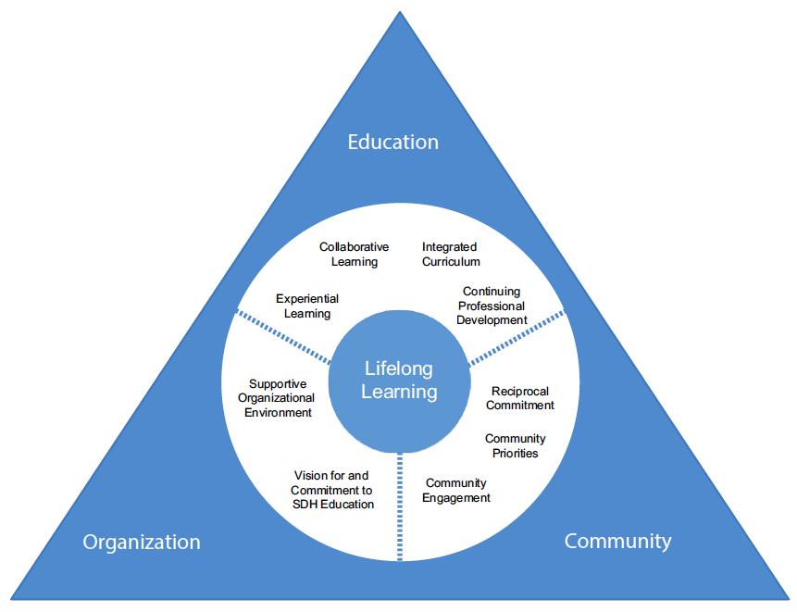
Framework for Lifelong Learning
SOURCE NASEM (National Academies of Sciences, Engineering, and Medicine). 2016. A framework for educating health professionals to address the social determinants of health. The National Academies Press.
doi: 10.17226/21923
Notes:
From workshop video see Julian Fisher [0:50-3:40; 7:45-10:04]
https://www.youtube.com/watch?v=TKRgkEY2xeY&list=PLGTMA6QkejfhAmRC2HbVGC460j7RyU9WW&index=3
In the report prepublication see:
Page 18: https://www.nap.edu/read/25711/chapter/3#18
See the NASEM report, A Framework for Educating Health Professionals to Address the Social Determinants of Health
https://www.nap.edu/catalog/21923/a-framework-for-educating-health-professionals-to-address-the-social-determinants-of-health

Slide 20
Small Group Activity
Divide into small groups to further discuss innovative models with an emphasis on the challenges of implementing interprofessional education focused on the social determinants and mental impacts.
Notes:
ACTIVITY: What other models or frameworks are there for interprofessional education for addressing the SDH/SDMH?

Slide 21
Recruiting and Supporting a Diverse Workforce: Highlights
A diverse health workforce, drawn from the community that it serves, is best suited to help the community and patients address social determinants of mental health. (Horne)
The Minority Fellowship Program (MFP) was created in 1973 in order to increase the number of ethnic minorities in mental health professions and to provide more culturally competent care to an increasingly ethnically diverse population in the United States. (Schweiger)
The MFP builds on this [shared experience] by affirming and validating the fellows’ life experiences, building a space where fellows can be authentic, promoting self-efficacy, building community, and empowering creativity. (Nguyen)
The main role of a mentor is forging a path that supports the mentee in achieving as much as possible. (BigFoot)
Notes:
ACTIVITY: Reflect upon your own lifelong learning commitment to educating others about the social determinants of mental health through the lens of diversity
In the report prepublication see:
Page 25: https://www.nap.edu/read/25711/chapter/4#25

Slide 22
Critical Elements
. . . for recruiting, supporting, retaining, and promoting a diverse workforce include:
Organizational support
Opportunity to be authentic
Support for students and professionals
Integration with community
Mentorship
Community definitions of well-being and success
Self-care and support
Notes:
From workshop video see building and developing a workforce
Wendi Schweiger [4min]
https://www.youtube.com/watch?v=dPNj8zryrnI&list=PLGTMA6QkejfhAmRC2HbVGC460j7RyU9WW&index=5
Andrew Dailey [3min]
https://www.youtube.com/watch?v=3-7OQiX_iio&list=PLGTMA6QkejfhAmRC2HbVGC460j7RyU9WW&index=6
Robert Horne [0-10:00min]
https://www.youtube.com/watch?v=b5Rk4epjaYQ&list=PLGTMA6QkejfhAmRC2HbVGC460j7RyU9WW&index=8&t=607s
Duy Nguyen [0-11:00min]
https://www.youtube.com/watch?v=jUi_NG6B9u4&list=PLGTMA6QkejfhAmRC2HbVGC460j7RyU9WW&index=8
Dolores Subia BigFoot [0-12:30min]
https://www.youtube.com/watch?v=Lvn0ryk4Srs&list=PLGTMA6QkejfhAmRC2HbVGC460j7RyU9WW&index=9
In the report prepublication see:
Page 28: https://www.nap.edu/read/25711/chapter/4#28

Slide 23
Experiential Learning In and Out of the Classroom: Highlights
Experiential learning requires a community that is ready and receptive to building partnerships; students who are engaged and motivated to make a difference, and faculty who are committed to doing the hard work to bring communities and students together. (Talib)
It can be difficult for refugees to open up about their past, so people working with them must take the time to gain trust in order to build a relationship of mutual honesty and openness. (Mouity)
When building relationships between academia and communities, it is critical that faculty members be intentional and sincere…Communities can sense if an academic is “trying to meet a quota” or check the boxes for community engagement. (Jennings-Bey)
[The students] all agreed that community- and project-based classes were preferable to traditional classes… [but] that not all students are passionate about the same things, so schools should offer varying levels of engagement and the ability to choose projects that meet students’ interests. (Walker, Hamlin, Vencel)
An academic could team up with a practitioner in order to run a community-based project giving students the opportunity to learn different aspects of the work from different people. (Shank)
Community-based learning opportunities need to be flexible, based on community needs and goals, and need to be part of a long-term commitment between communities, institutions, faculty, and students (Lipman)
Notes:
ACTIVITY: Reflect upon your own lifelong learning commitment to educating others about the social determinants of mental health through community-engaged learning
In the report prepublication see:
Page 35: https://www.nap.edu/read/25711/chapter/5#35

Slide 24
Community Perspective
In the classroom: Love Mouity moved to Syracuse, New York as a refugee from Congo-Brazzaville in 2007. He now works as a coordinator for refugee outreach for Catholic Charities of Onondaga County, and also co-teaches an interprofessional class at Syracuse University on refugee health.
Out of the classroom: Timothy "Noble" Jennnings-Bey is CEO of the Street Addictions Institute Inc. and Director for the Trauma Response Team, which responds to shootings and homicides in Syracuse, New York. Jennings-Bey grew up in Syracuse in a low-income, violent neighborhood, and now serves as a leader in his community and works closely with academics and students at Syracuse University.
Notes:
From workshop video see Lane/Mouity/Jennings-Bey [4:00-24:00]
https://www.youtube.com/watch?v=287NT7qnG9M&list=PLGTMA6QkejfhAmRC2HbVGC460j7RyU9WW&index=13&t=969s
In the report prepublication see:
Page 37: https://www.nap.edu/read/25711/chapter/5#37

Slide 25
Interprofessional Collaborations
Student perspective: Walker said that his program has been largely theory and classroom-based, so learning with students who participate in more real-life experiences (e.g. working in a clinic) would bring a much-needed balance to the program.
University president perspective: Shank added that another option for interprofessional education is to have instructors from different disciplines working together with traditional health professions faculty. For example, an academic could team up with a practitioner in order to run a community-based project, giving students the opportunity to learn different aspects of the work from different people.
Notes:
Student perspective [0-13:30min]
https://www.youtube.com/watch?v=Oe6LrAbX-CE&list=PLGTMA6QkejfhAmRC2HbVGC460j7RyU9WW&index=13
In the report prepublication see:
Pages 39, 41: https://www.nap.edu/read/25711/chapter/5#39

Slide 26
Turning Experience into Policy: Highlights
Many Veterans chose not to use the word “disorder” [in the post-traumatic stress acronym] citing that after what they went through in battle, it would be a disorder not to be affected by the experience. (Moulton)
It was also stated that, in the end, legislation and public policy may help the most—even more than the delivery of quality health care—in reducing these inequities. (Benedek)
Putting the patient in the center means seeing the whole person—including his or her family, job, community, and unique situation—rather than just his or her medical issue or diagnosis. (Keefe)
Health professionals need to be prepared and willing to work cross-sectorally in order to address social determinants. (Carter)
Students need to be trained to see “health in all policies” and to advocate for all types of policy on all levels, (Fisher)
Notes:
ACTIVITY: How might you design a “health in all policies” learning experience?
In the report prepublication see:
Page 47: https://www.nap.edu/read/25711/chapter/6#47

Slide 27
Role of Health Education in Policy
Leverage the skillsets of other professions like counseling, social work, and psychology, for interprofessional education and training in policy advocacy
Offer a broad continuum of engagement in advocacy, with a core foundation of advocacy skills that all students are trained in.
Examples:
take students to a state capitol or to Capitol Hill for advocacy days & train students in how to:
write letters to influence policy;
know who their representatives are; and
use their “voice” in terms of policy development.
Notes:
ACTIVITY: What are some examples of the role of health education in policy?
In the report prepublication see:
Page 55:

Slide 28
Closing
Think about your own commitments to learning and how, by developing an education contract with yourself, how you as a health professional and/or an educator can influence colleagues and leaners well after this workshop ends.
Notes:
ACTIVITY: Revisit your lifelong learning commitment to educating others about the social determinants of mental health through the lens of diversity
In the report prepublication see:
Pages 55-56

